Slide 1
机器人与人工智能实验室 Robotics and Artificial Intelligence Laboratory
WELCOME TO

Slide 2
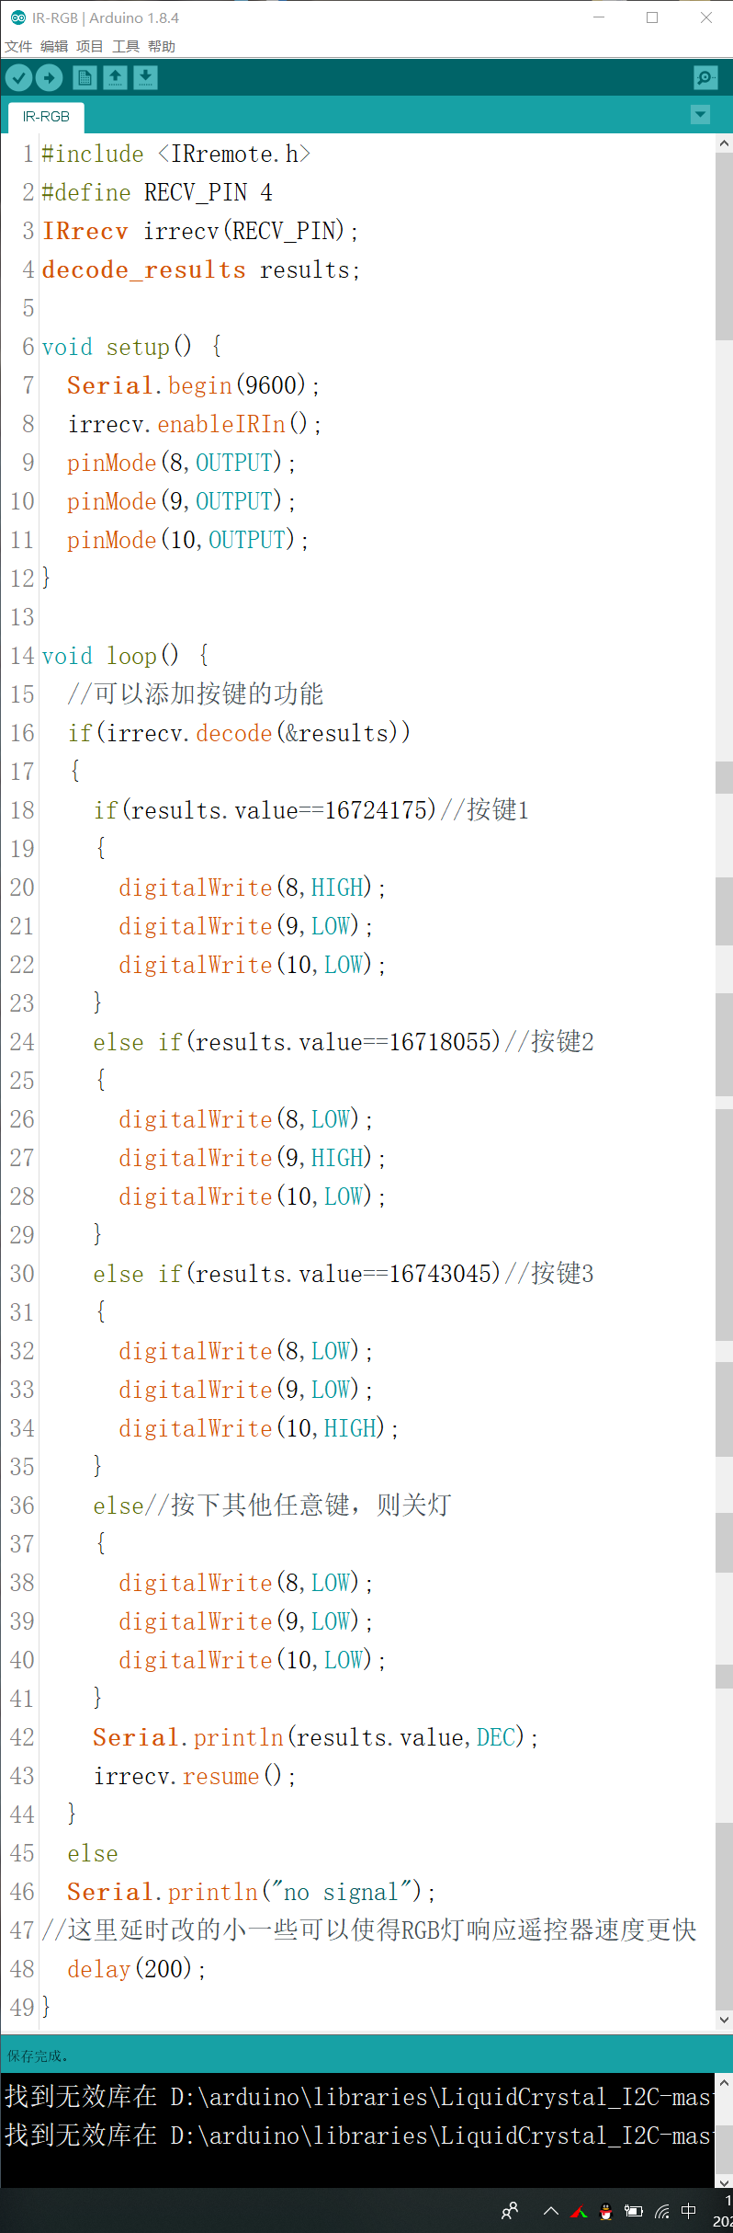
RGB IR Controlling
Change the three primary colours of the RBG light through the three buttons 1, 2, and 3 of the remote control, and press any other button to turn off the light.

Slide 3
RGB IR Controlling
Next:

Slide 4
RGB IR Controlling
Next:

Slide 5
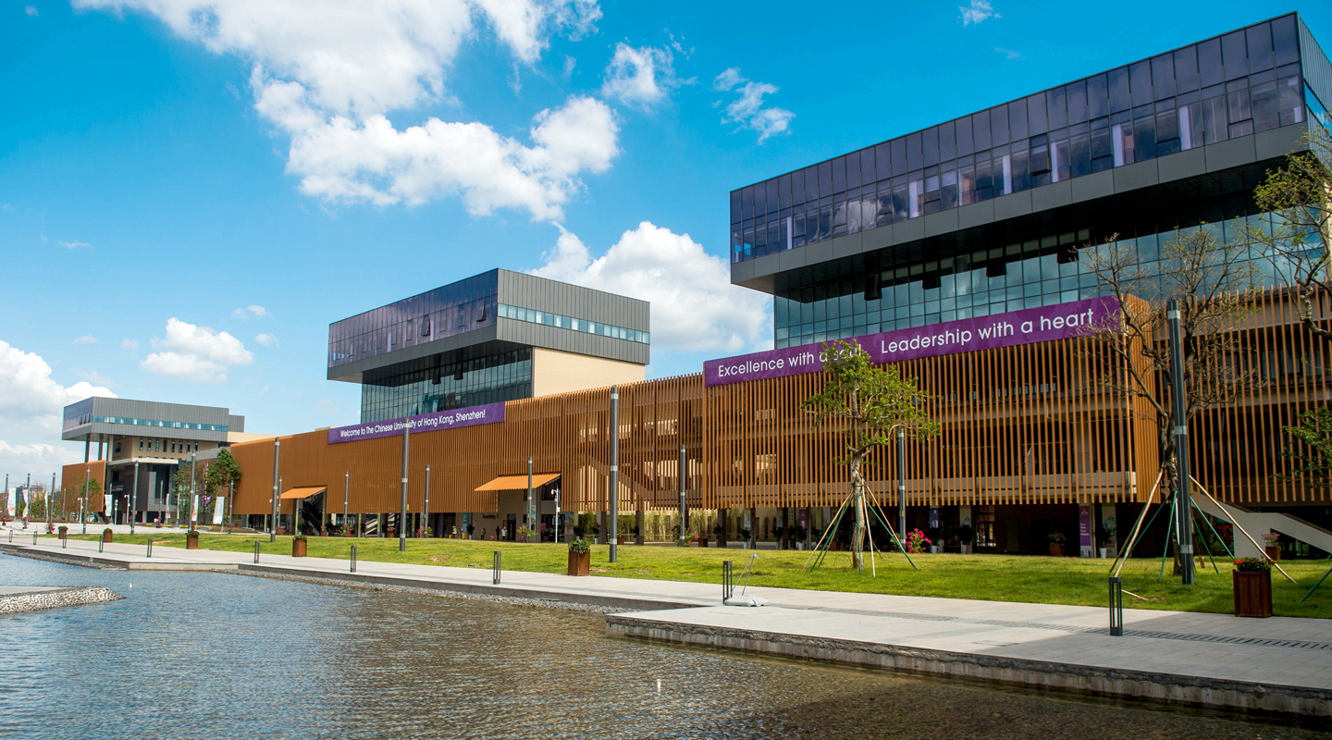
THANK YOU
林天麟 教授
香港中文大学（深圳）
机器人与人工智能实验室
WeChat: tinlunlam

